Slide 1
AI SMART WASTE SEGREGATION SYSTEM

Slide 2
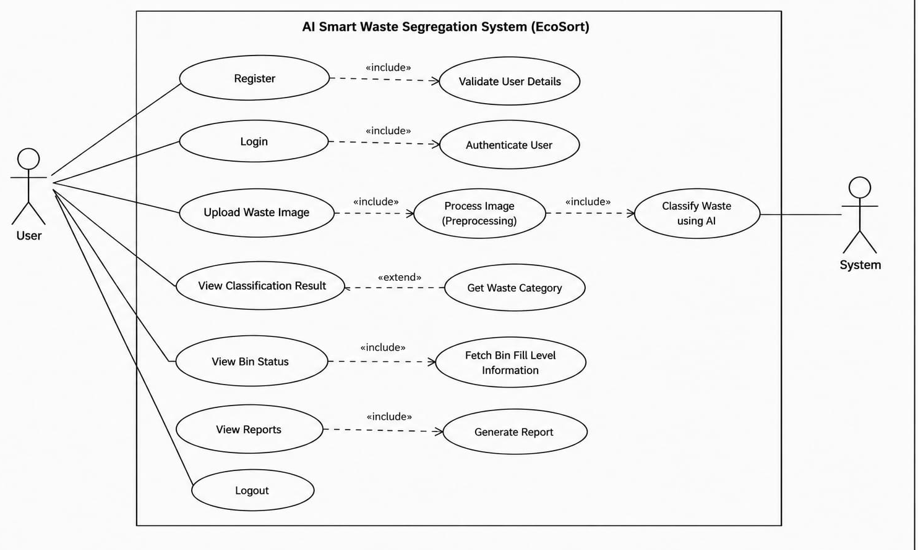
USE CASE DIAGRAM

Slide 3
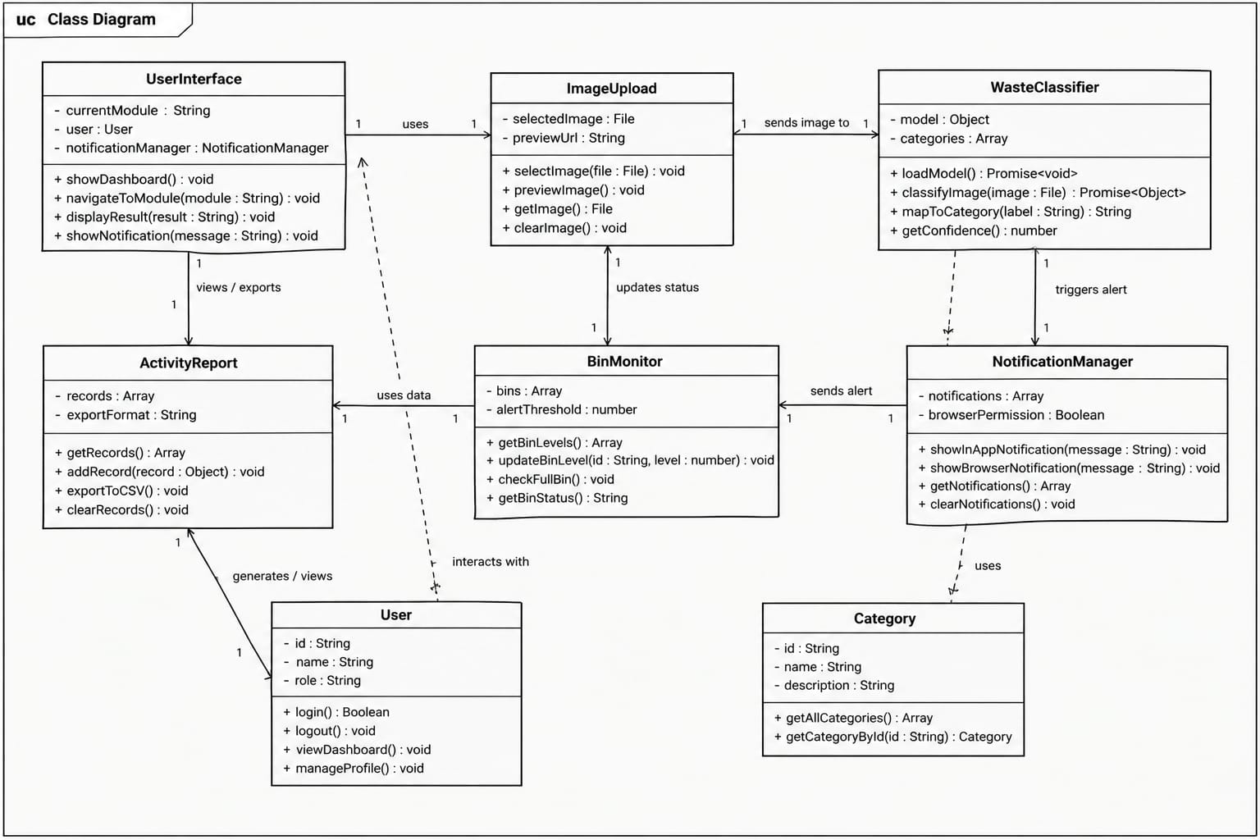
CLASS DIAGRAM

Slide 4
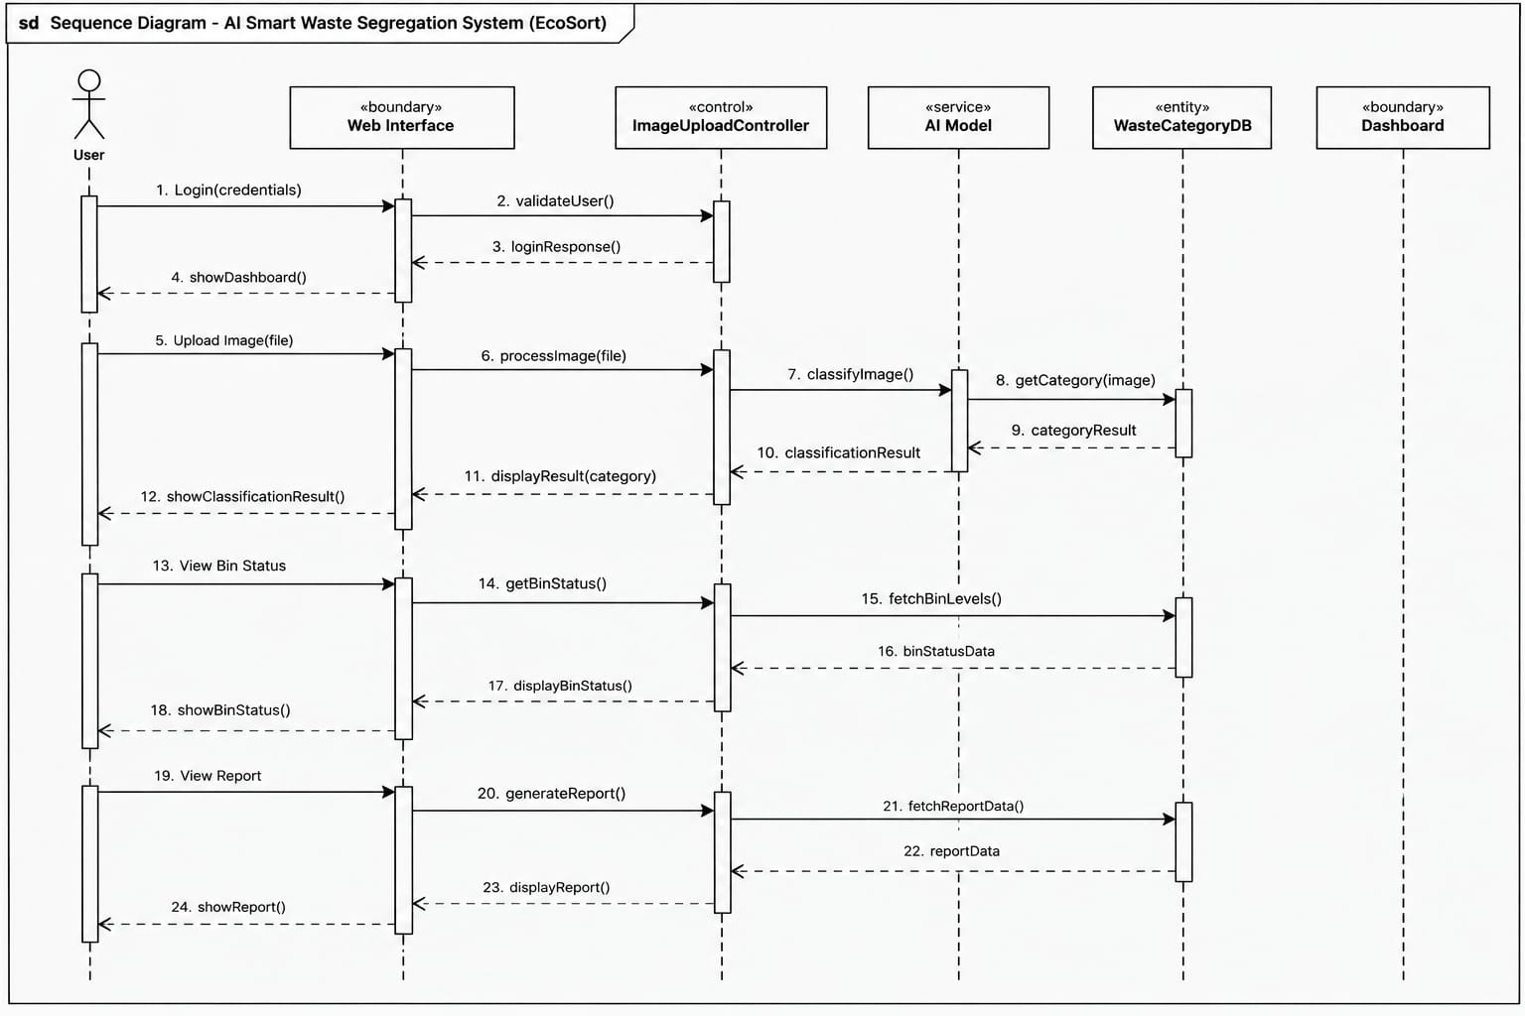
SEQUENE DIAGRAM

Slide 5
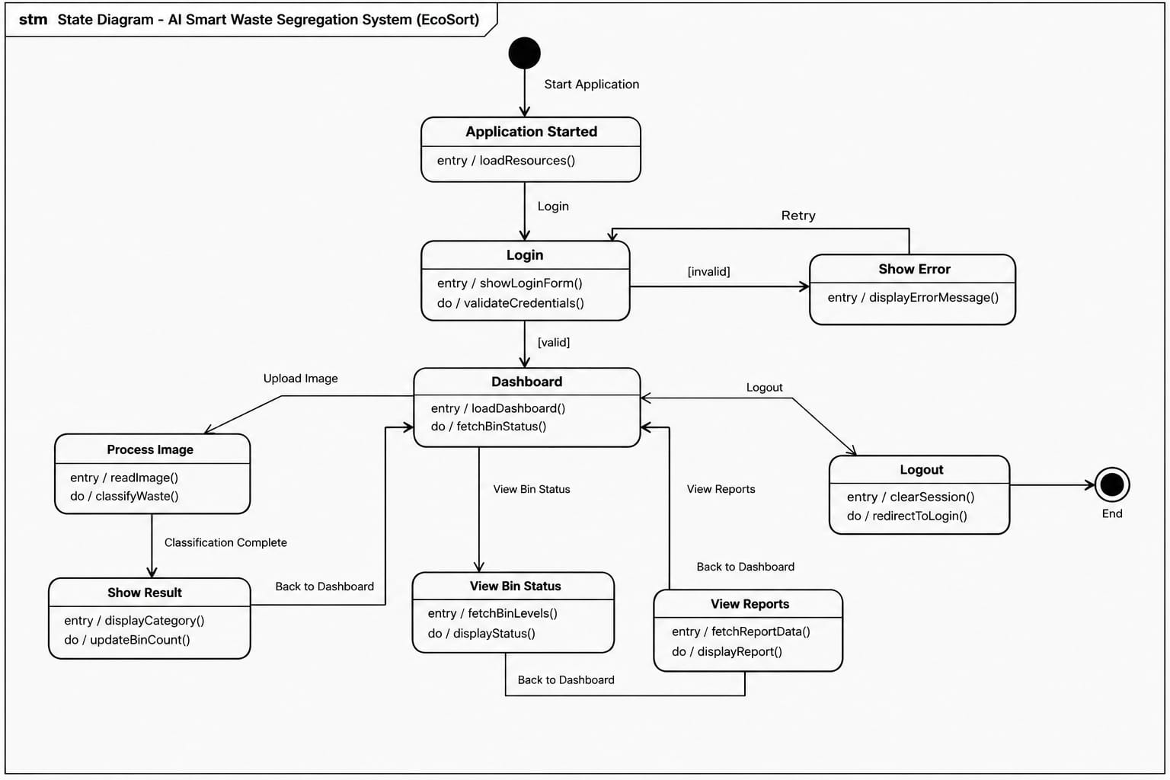
STATE DIAGRAM

Slide 6
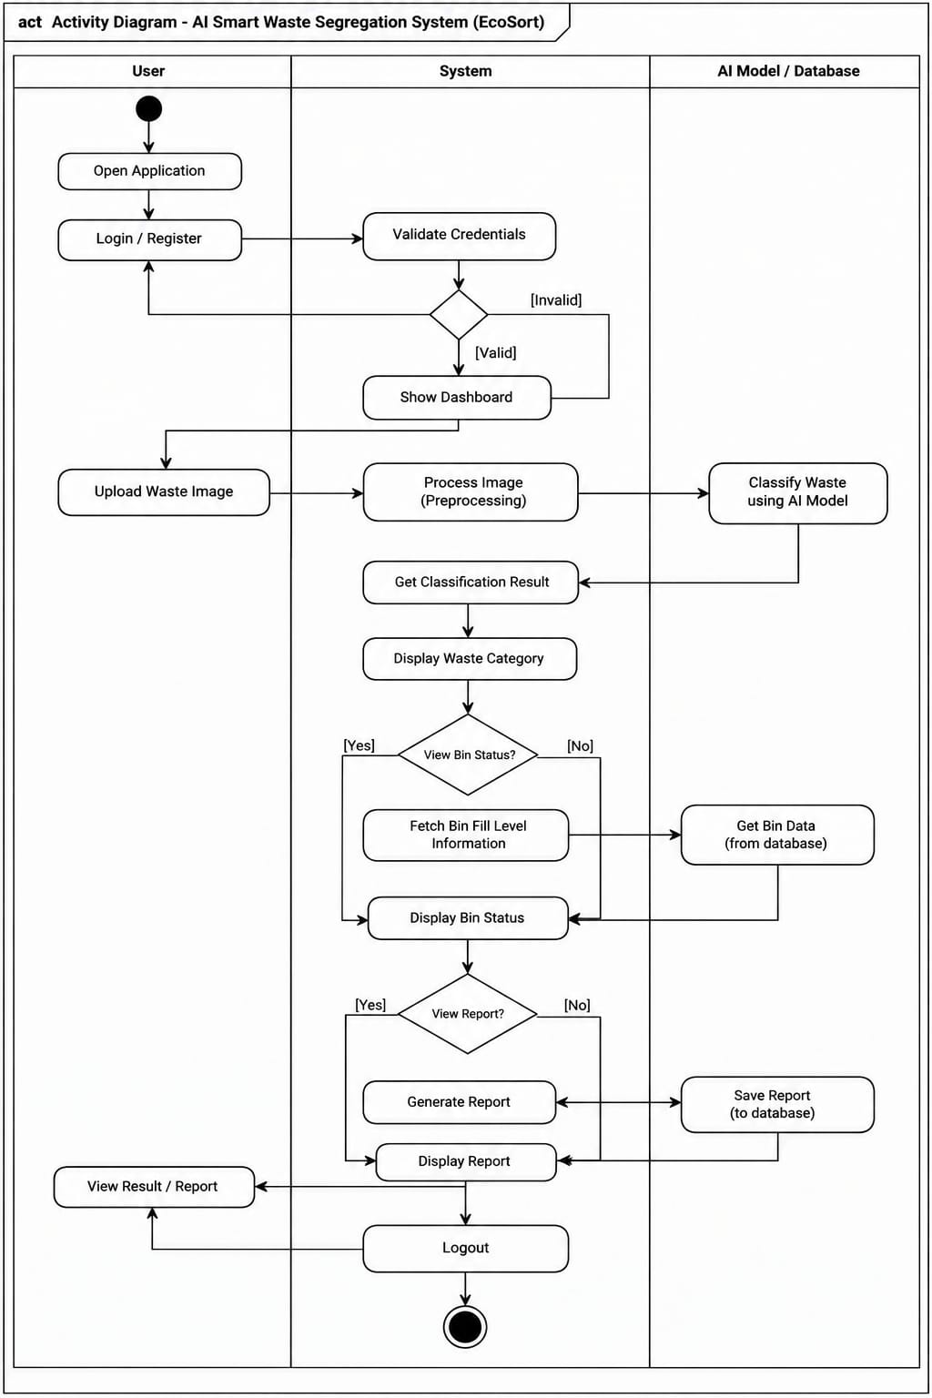
ACTIVITY DIAGRAM

Slide 7
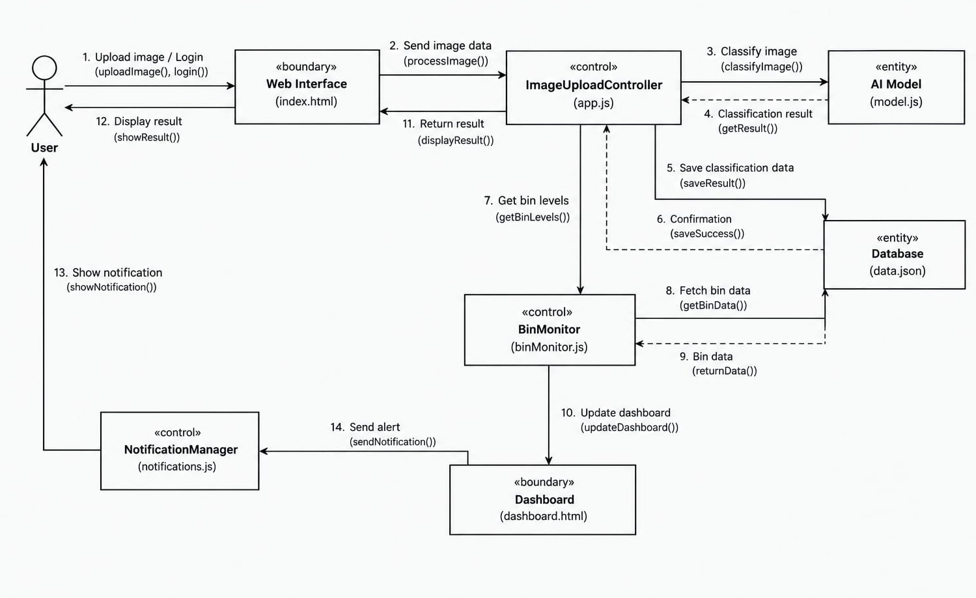
COLLABORATION DIAGRAM

Slide 8
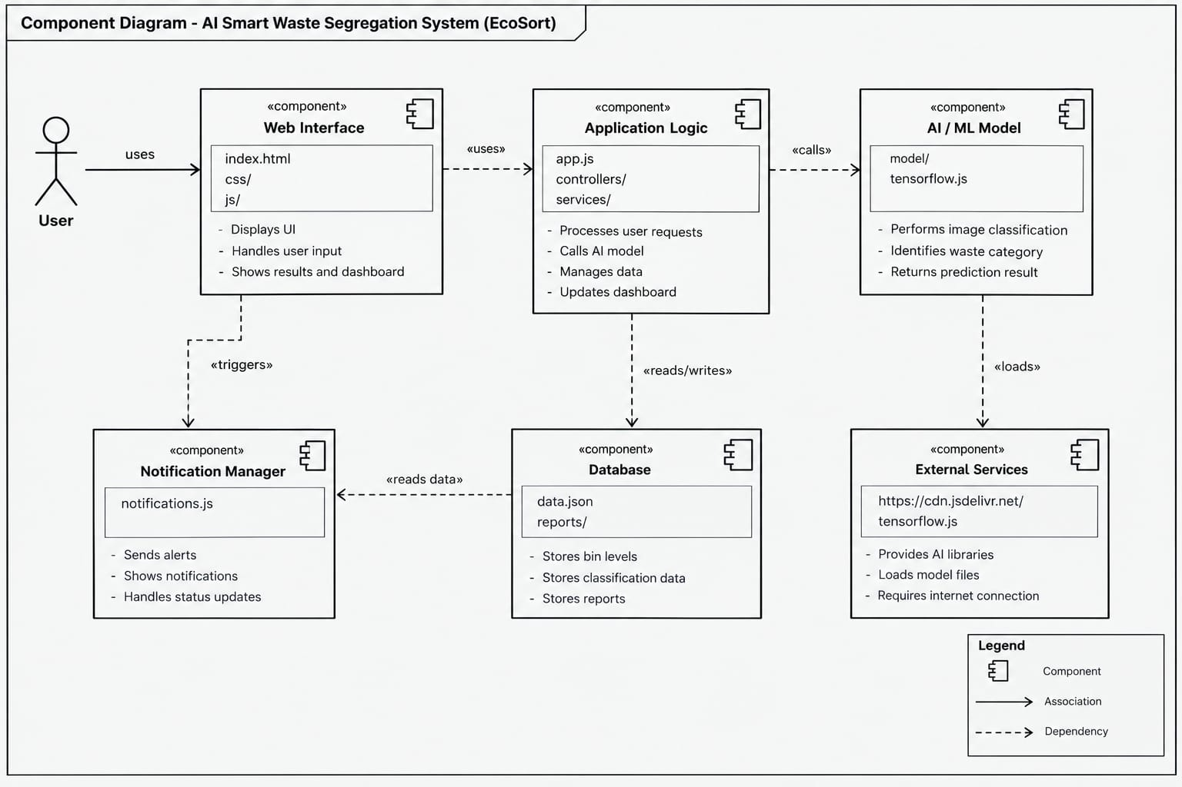
COMPONENT DIAGRAM

Slide 9
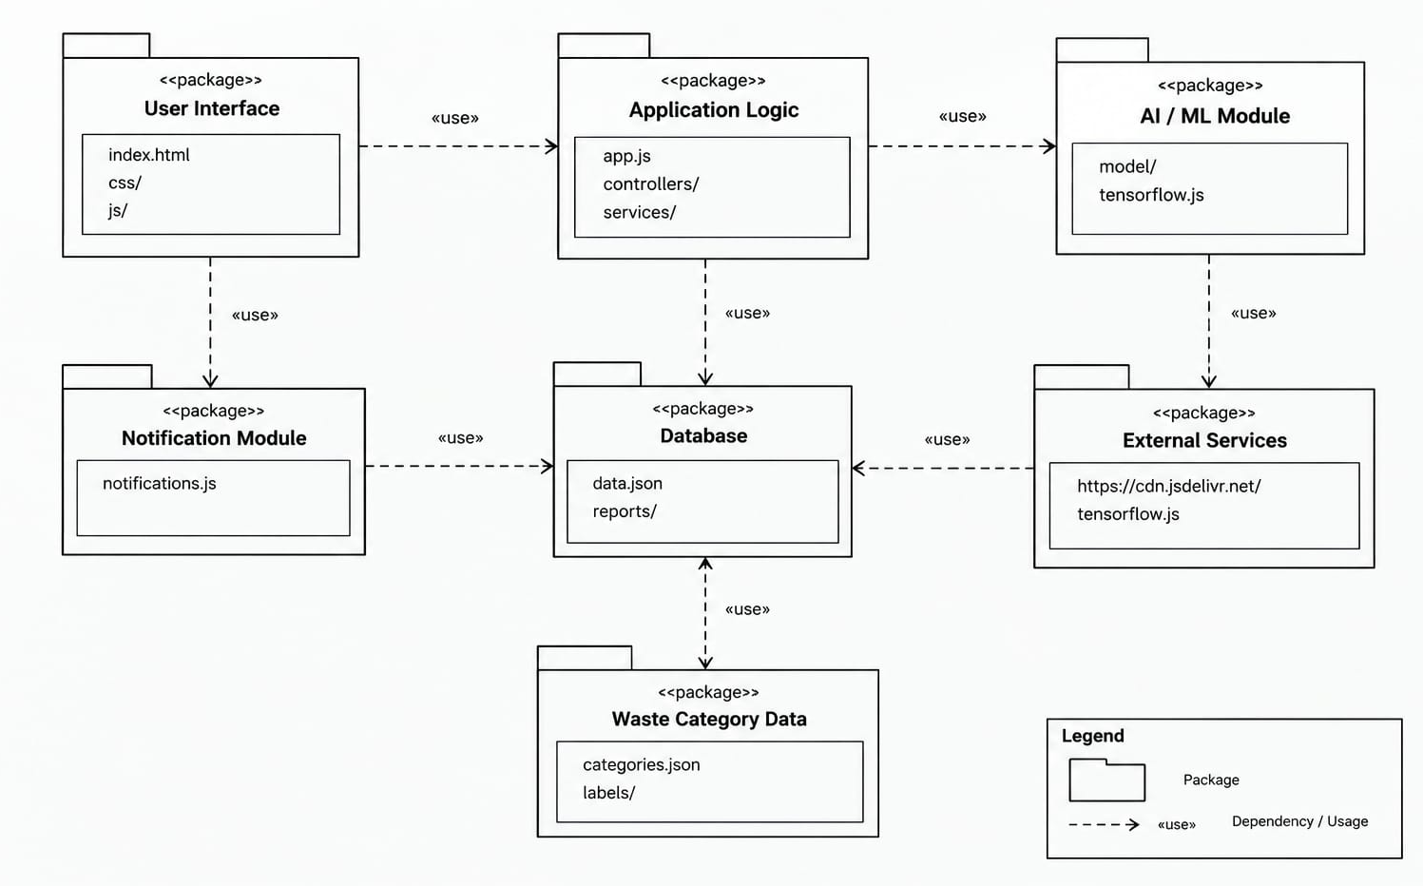
PACKAGE DIAGRAM

